Slide 1
Training > Photography
Photography

Slide 2
SHOWSTOPPER
PHOTOGRAPHY
TAKE photos
like THIS.

Slide 3
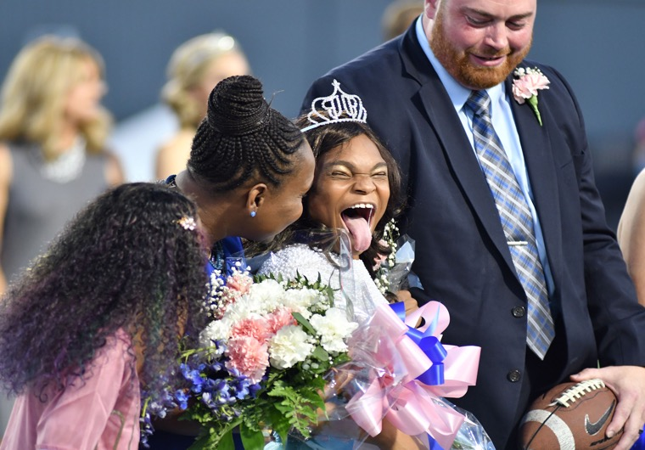
GRAND PRIZE - ALINA PERET
Bryant High School - Bryant, AR

Slide 4
GREAT PHOTOS lead to SHOWSTOPPER
spreads in your yearbooks.

Slide 5
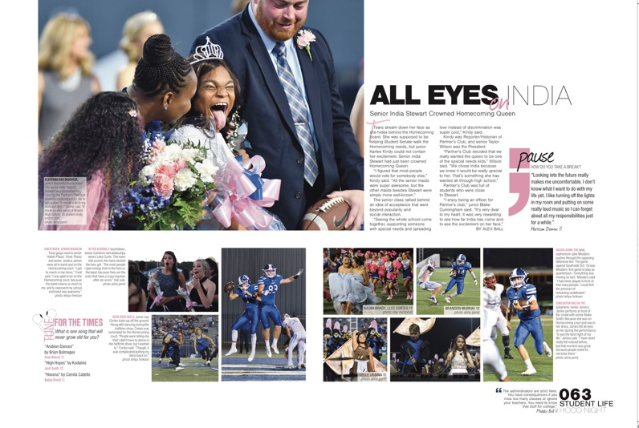
BRYANT HIGH SCHOOL
BRYANT, AR

Slide 6
QUOTE
“INDIA was chosen for HOMECOMING court, but she did not know she would be crowned QUEEN. I had my camera up and ready for any type of REACTION - unsure I would get one. She didn’t disappoint. Out of 960 PICTURES I took that night, this one shows the atmosphere of BRYANT HIGH SCHOOL because the winner isn’t someone popular or status quo. As a special needs student, India was chosen by her PEERS simply for being herself.”
ALINA PERET - photographer

Slide 7
JOSIE PRINGLE - BRYANT HIGH SCHOOL
BRYANT, AR

Slide 8
JOSIE PRINGLE - BRYANT HIGH SCHOOL
BRYANT, AR
Notes:
If staff says it can't use a full-page photo because they have to do 3-times coverage, tell them they could do it for a theme or divider spread. It's a sin to bury a great photo on a spread with 20 other photos. Let it speak. Readers always love it.

Slide 9
GREAT PHOTOS contain three SIMPLE elements.

Slide 10
GREAT PHOTOS HAVE
Good LIGHT
Great COMPOSITION
STORYTELLING elements

Slide 11
IT ALL STARTS WITH COMPOSITION
The ARRANGEMENT of ELEMENTS in a photo used to EMPHASIZE certain SUBJECTS over others & emphasize the CENTER OF VISUAL INTEREST.

Slide 12
COMPOSITION TECHNIQUES
Rule of Thirds
Leading Lines
Repetition
Worm’s Eye View
Bird’s Eye View
Reaction
Fill the Frame
Framing
Lighting
Selective Focus
Depth & Layers
Simplicity

Slide 13
RULE OF THIRDS - AIMEE ROBERTS
Franklin High School, NC

Slide 14
RULE OF THIRDS - AIMEE ROBERTS
Franklin High School, NC

Slide 15
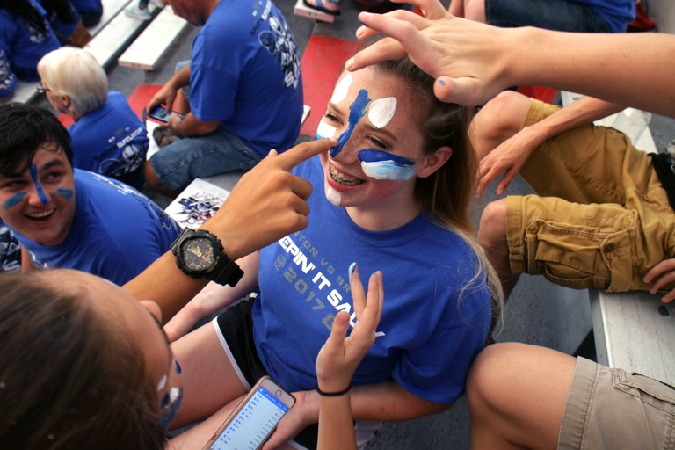
LEADING LINES - ALEX MELTON
Bryant High School, AR

Slide 16
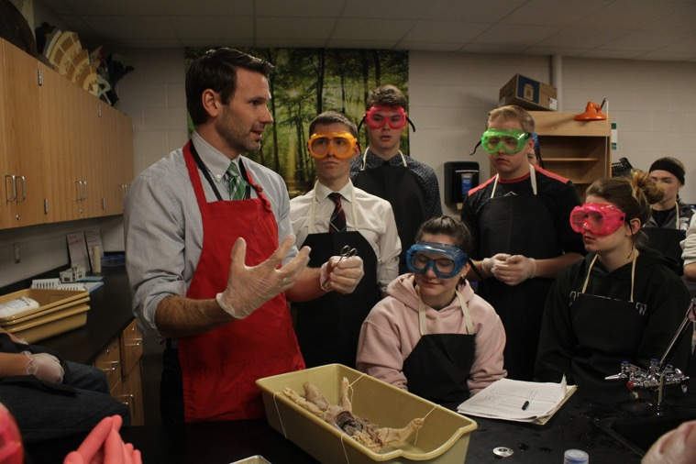
REPETITION - JAZMINE HAWKINS
Stockbridge High School, MI

Slide 17
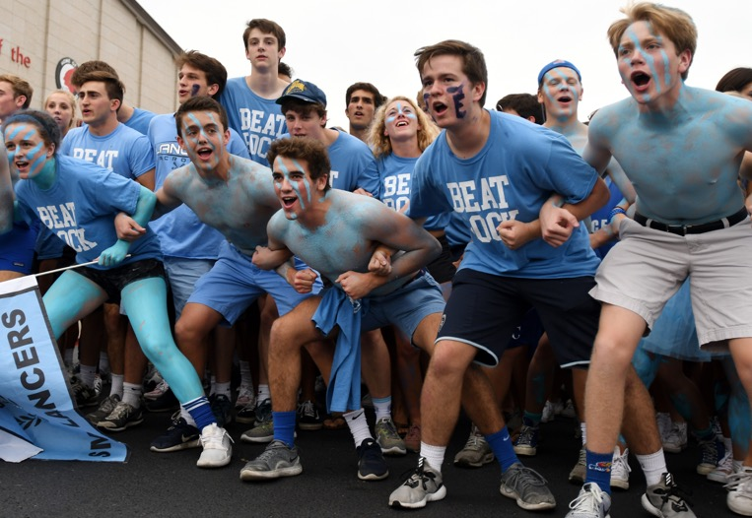
WORM’S EYE VIEW - ISABEL MILLER
Shawnee Mission East High School, KS

Slide 18
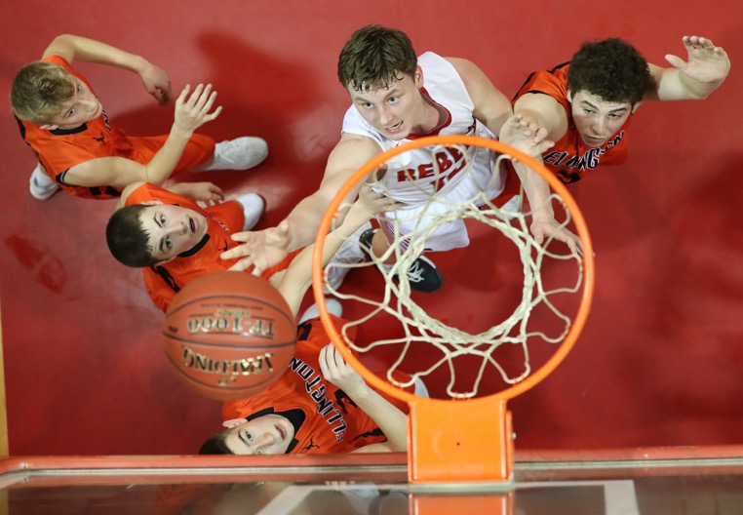
BIRD’S EYE VIEW - LIZA KING
Richland R-1 High School, MO

Slide 19
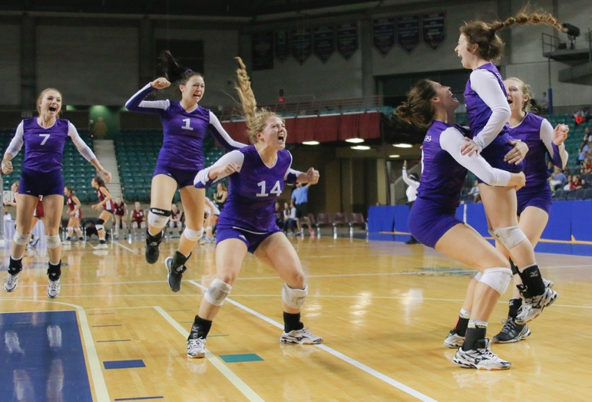
REACTION - MADDY EMERSON
Pittsburg High School, KS

Slide 20
FILL THE FRAME- MADDY EMERSON
Pittsburg High School, KS

Slide 21
FRAMING - SHUMESA MOHSIN
Tokay High School, CA
Notes:
Arm around player’s head creates ‘framing’ of subject’s face

Slide 22
How would you use this PHOTO on a SPREAD?

Slide 23
LIGHT - ALI MASHBURN
Westlake High School, TX

Slide 24
WESTLAKE HIGH SCHOOL
Austin, TX

Slide 25
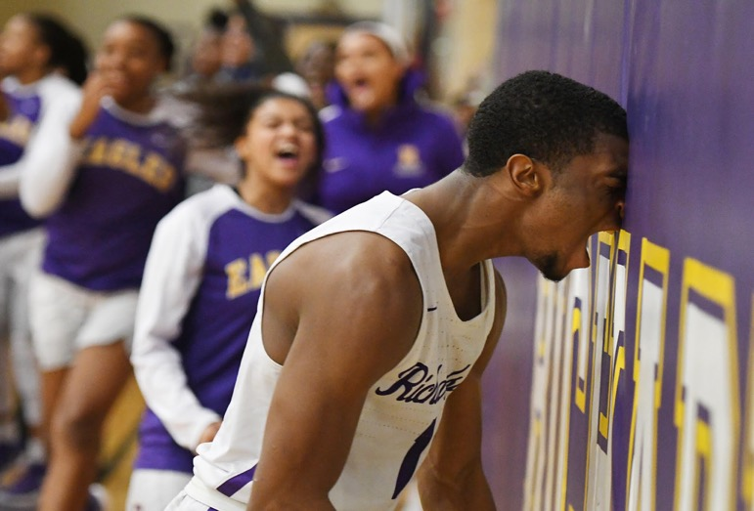
SELECTIVE FOCUS - CHAD BYRD
Richardson High School, TX

Slide 26
How was it used on a real SPREAD?

Slide 27
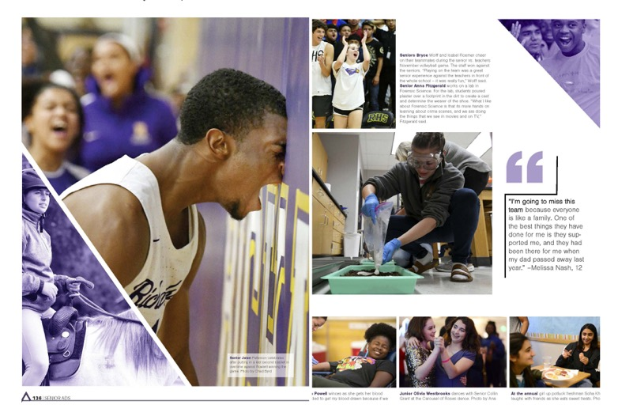
RICHARDSON HIGH SCHOOL
Richardson, TX

Slide 28
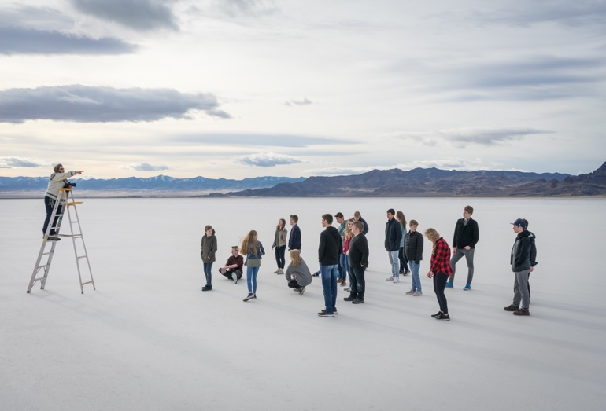
DEPTH/LAYERS - HAYDEN WEBB
Karl G. Maeser Prep Academy, UT
Notes:
Depth/layers is realizing a photo has a foreground, middle ground and background, all contributing to the overall story of the photo. Some images work better when all three of these layers are in focus and represented in the photo.

Slide 29
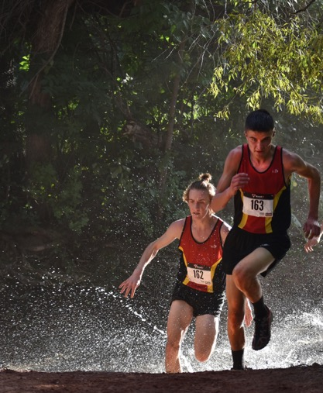
SIMPLICITY - FAITH ROTH
Coronado High School, CO
Notes:
Simplicity is controlling the background by observing how that background content could distract from the center of visual interest. If you can control or frame up the background to eliminate distracting elements, do it.

Slide 30
STOP ACTION creates DRAMATIC images.
Use a fast shutter speed to freeze
a subject’s movement without blur.

Slide 31
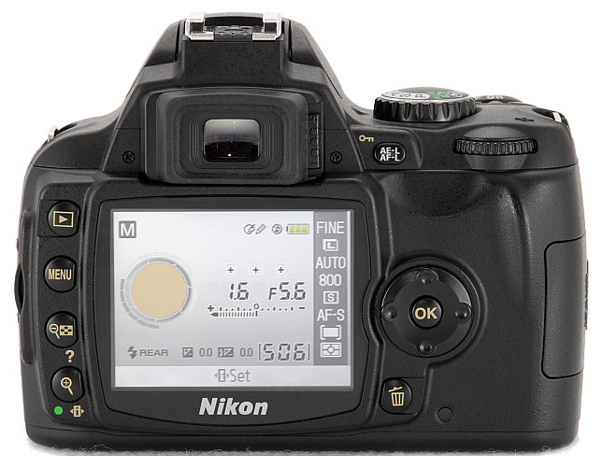
Introduction to Digital Photography

Slide 32
Introduction to Digital Photography
Basic Camera Features
Most digital SLR cameras have similar basic features, including:
White Balance Adjustment
Aperture/Exposure Control
Shutter Speed Control
Quality/Sharpness Settings
Red-Eye Reduction
“Macro” Mode and Preset Photo Modes
Video/Audio Recording Capability

Slide 33
Introduction to Digital Photography
White Balance
White balance adjusts colors based on the light you are shooting (indoor vs. outdoor) – usually referred to as COLOUR TEMPERATURE.
With proper white balancing, white objects in your photos appear as white instead of with an orange or blue cast.
Some digital cameras have an auto-white balance feature, but be careful as it isn’t always accurate.
You can correct white-balance problems on the computer (with programs such as Photoshop).

Slide 34
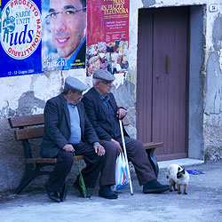
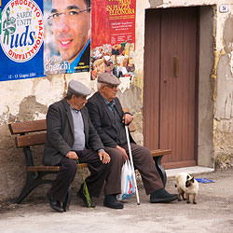
Introduction to Digital Photography
Incorrect White Balance (blue tint) – camera not adjusted for outdoor photos
Correct White Balance camera adjusted for outdoor photos – no unusual tinting

Slide 36
Introduction to Digital Photography
Aperture/Exposure Control
A camera’s aperture is the opening that allows light into the lens (think of the iris in your eye).
Setting the aperture correctly is important for ensuring properly exposed photos (meaning the correct amount of light).
A large aperture setting lets in more light and is useful in more darkly lit situations.
A small aperture setting is better suited for brightly lit scenes.
Most digital cameras feature an auto-exposure setting that automatically adjusts the aperture as lighting conditions change.

Slide 37
Introduction to Digital Photography
Aperture/Exposure Control (contd)
Professional photographers rarely use auto-exposure mode, preferring instead to control the aperture setting themselves.
Different aperture settings are referred to as F-Stops.
The smaller the F-Stop number, the larger the aperture opening (yes, this is a little confusing).
Under-exposed = not enough light (appears too dark)
Over-exposed = too much light (appears washed out)
Under-exposed
Over-exposed

Slide 38
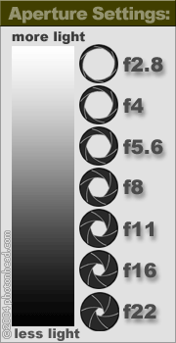
Introduction to Digital Photography
Brightness is reduced as light passes through the aperture of a camera lens.

Slide 40
Introduction to Digital Photography
Depth of Field
The camera’s aperture setting also controls the depth of field of your photos.
Depth of field is the range of distance from the camera lens that appears in sharp focus.
The smaller the aperture opening (or higher F-Stop number), the greater the depth of field (or larger range of focus).
The larger the aperture opening (or smaller F-Stop number), the shallower the depth of field (small range of focus).

Slide 41
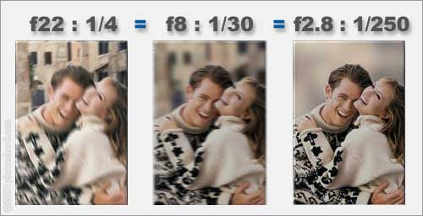
Introduction to Digital Photography
Depth of Field

Slide 42
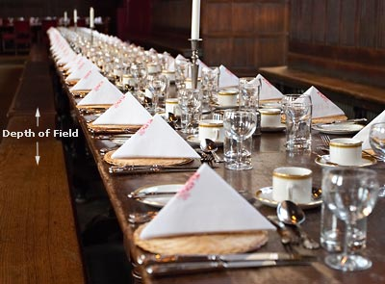
Introduction to Digital Photography
Depth of Field

Slide 43
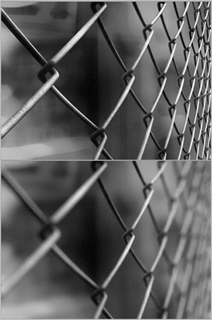
Introduction to Digital Photography
Depth of Field
Deep DOF
Shallow DOF

Slide 45
Introduction to Digital Photography
Shutter Speed
A camera’s shutter speed refers to the length of time the shutter stays open, allowing light to enter the camera.
The faster the shutter speed, the less light that enters the camera and the quicker the image is captured.
A good photographer knows how to make aperture settings and shutter speed work together!
As with exposure settings, most digital cameras have auto-shutter modes.
You should be aware of how different shutter speeds affect an image.

Slide 46
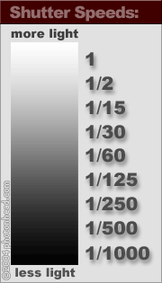
Introduction to Digital Photography
The longer exposures (such as 1 second ) give much more light to the film than a 1/1000 of a second exposure.

Slide 47
Introduction to Digital Photography
Shutter Speed
Shutter speed also needs to be adjusted depending on the type of subject being photographed.
Fast moving objects require a fast shutter speed (such as 1/500 of a second) – sports or actions shots
For shutter speeds lower than 1/125, you should use a tripod or the image will likely appear blurry

Slide 48
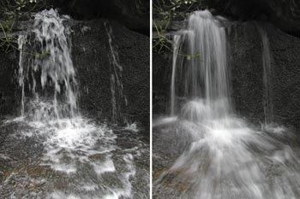
Introduction to Digital Photography
Shutter Speed
Fast Shutter – image motion is “frozen” in time
Slow Shutter – image motion is blurred

Slide 49
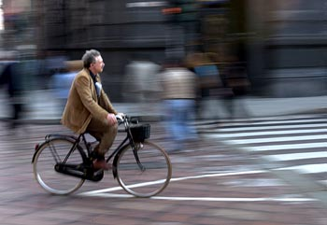
Introduction to Digital Photography
Shutter Speed
A slow shutter speed is used to blur the background as the camera pans along with the cyclist.

Slide 50
Introduction to Digital Photography
Shutter Speed
A long shutter speed can be set at night to record car headlights as trails.

Slide 51
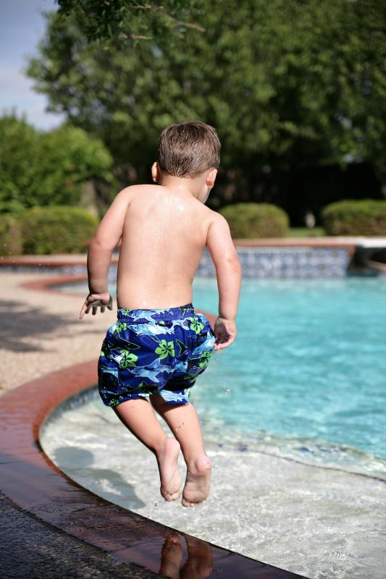
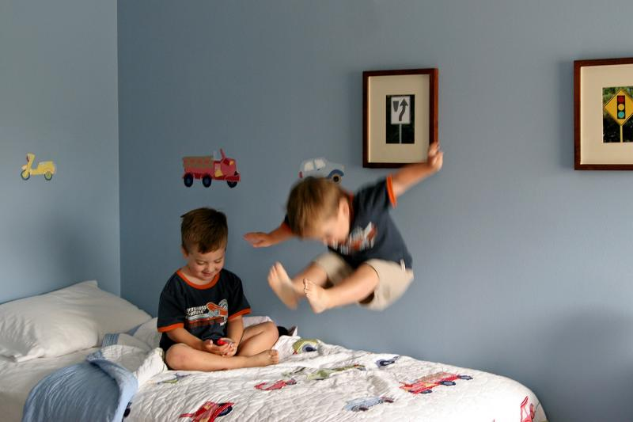
Introduction to Digital Photography
Shutter Speed
Slow Shutter – note blurred motion
Fast Shutter

Slide 53
Introduction to Digital Photography
Composition Tips
Your initial impulse may be to use the camera's LCD monitor instead of the viewfinder to compose pictures.
You can do this, but this technique can also result in "soft" focus images; holding a lightweight camera away from your body is an invitation for motion blur.
Holding the viewfinder to your eye provides built-in stabilization that helps ensure sharp images.
To stabilize the camera, hold it with one hand, and support it with the other.
Keep your elbows close at your side. Stand with your feet shoulder-width apart to steady the camera.

Slide 54
Introduction to Digital Photography
Composition Tips
Get close to your subject when possible.
This eliminates potentially distracting background details and focuses attention on your subject.
Pay attention to the background!
Use the Rule of Thirds! Avoid placing objects dead centre – this helps to create visual interest.
Try to take shots from interesting angles. Force people to see things in unique ways.

Slide 55
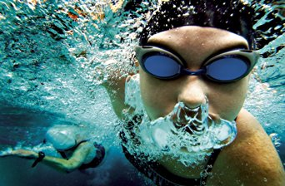
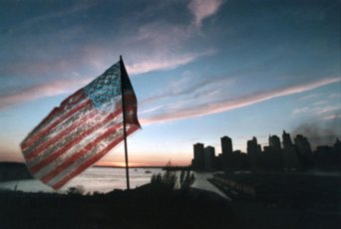
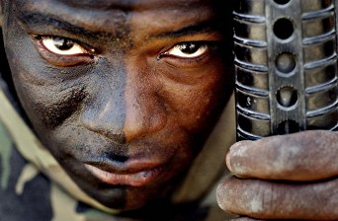
Introduction to Digital Photography
RULE OF THIRDS

Slide 56
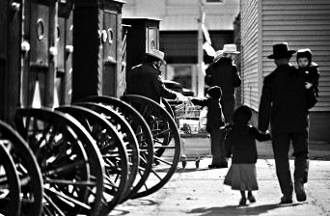
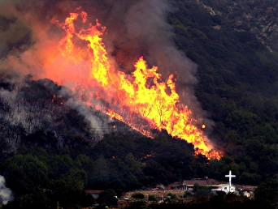
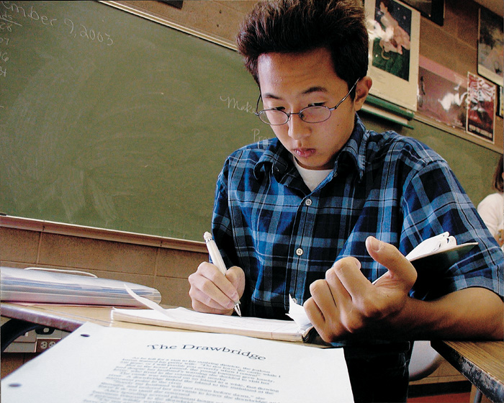
Introduction to Digital Photography
LEADING LINES/REPETITION

Slide 57
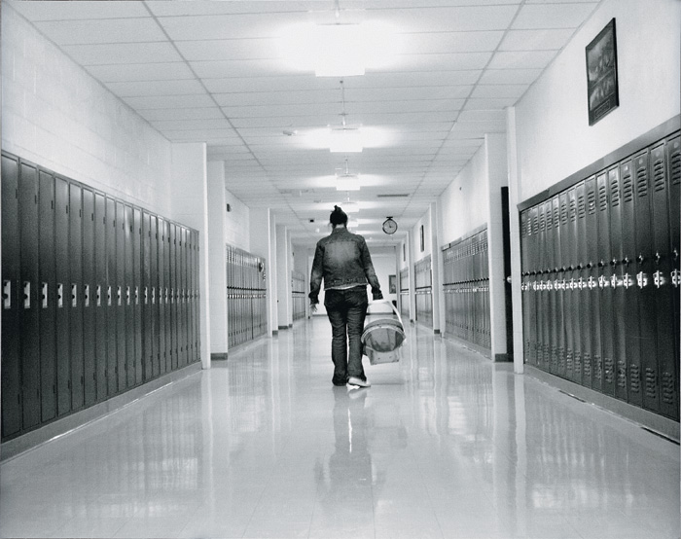
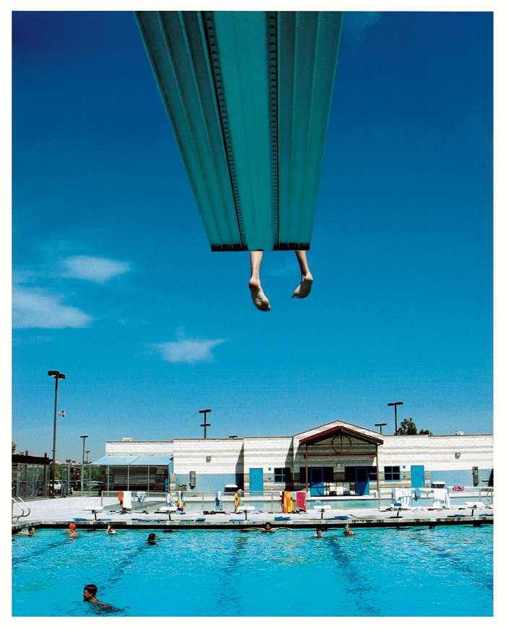
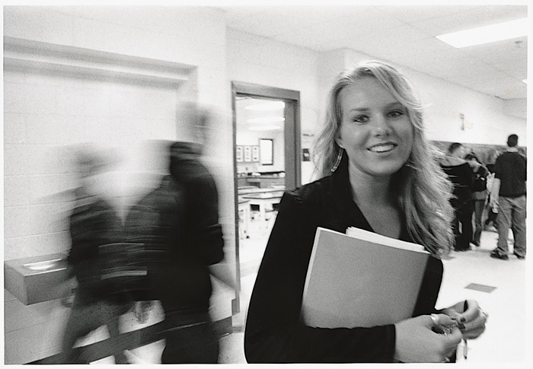
Introduction to Digital Photography
MORE LEADING LINES/SHUTTER SPEED

Slide 58
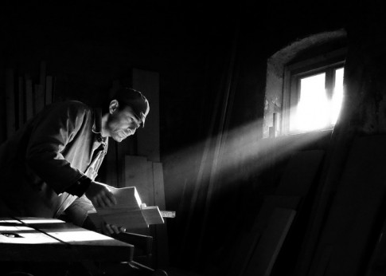
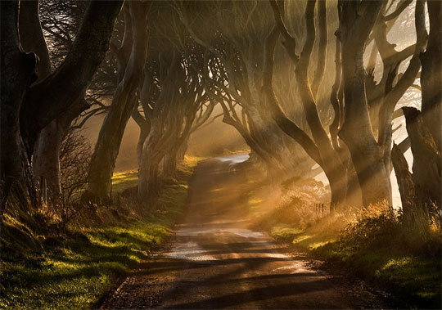
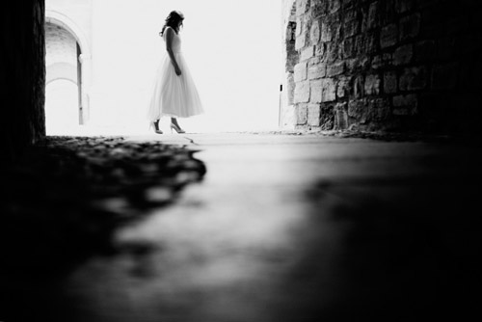
Introduction to Digital Photography
WORK WITH NATURAL LIGHT

Slide 59
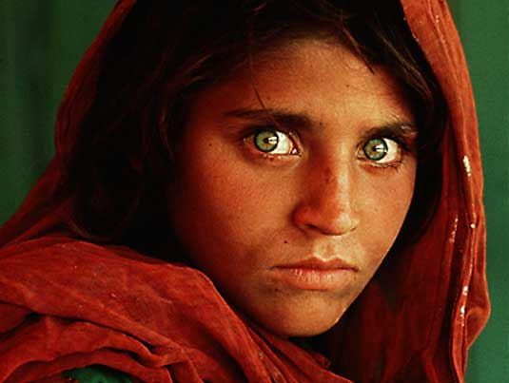
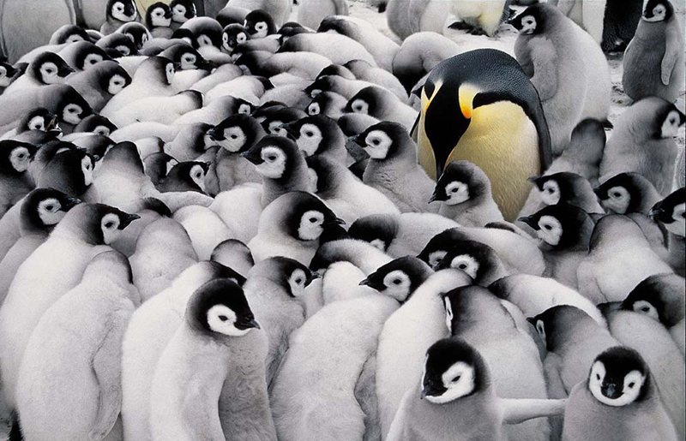
Introduction to Digital Photography
POWERFUL COMPOSITION

Slide 60
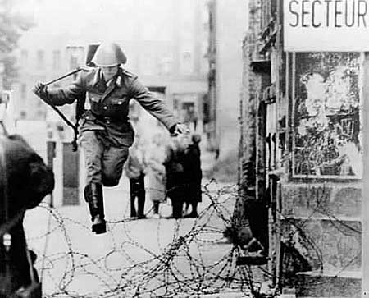
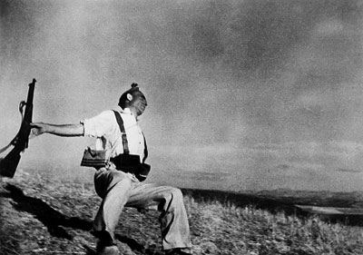
Introduction to Digital Photography
FROZEN MOMENTS

Slide 61
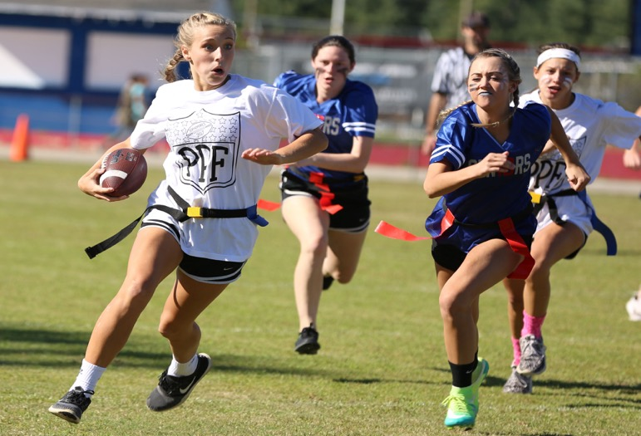
HALEY BONDURANT
Pace High School, FL

Slide 62
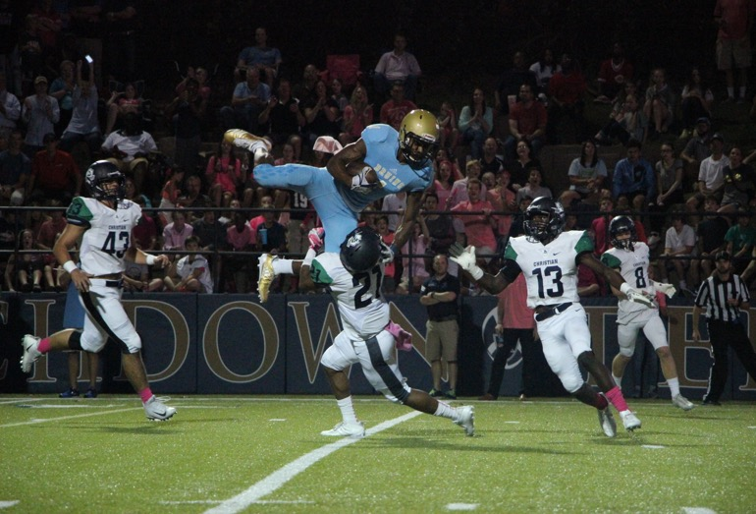
ABIGAIL BLANKENSHIP
Little Rock Christian Academy, AR

Slide 63
Used as a DOMINANT, this photo draws our EYES into the spread because of the
STOP ACTION.

Slide 64
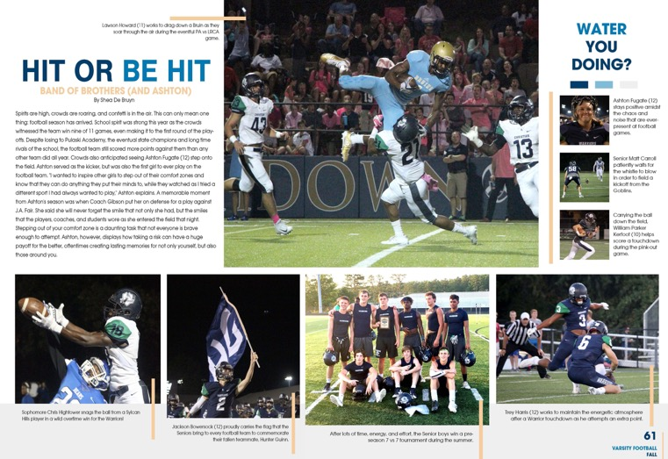
LITTLE ROCK CHRISTIAN ACADEMY
Little Rock, AR

Slide 65
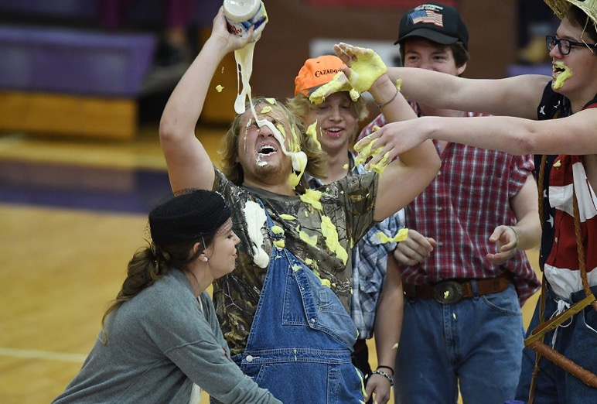
CHAD BYRD
Richardson High School, TX

Slide 66
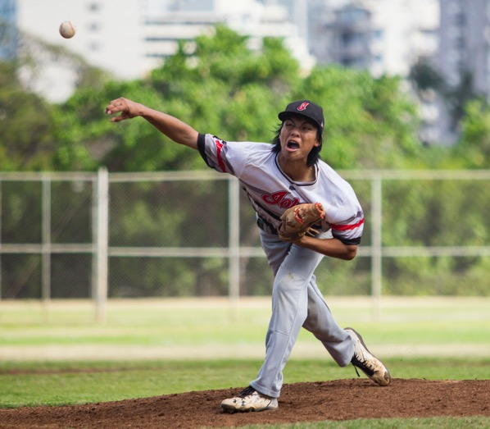
NIKYE MAKISHIMA
Lolani School, HI

Slide 67
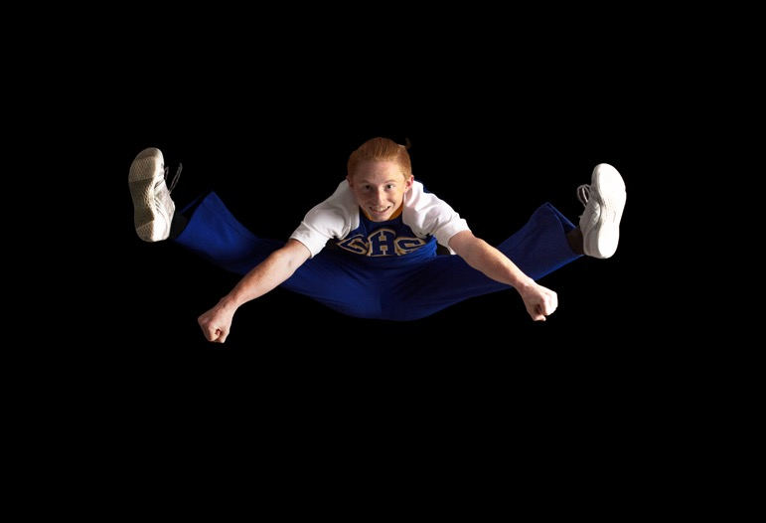
BECCA COOK
Corsicana High School, TX

Slide 68
ENVIRONMENTAL
PORTRAITS

Slide 69
STORYTELLING images ideal
for the PEOPLE section, STUDENT profile MODULES, speciality SPREADS,
special SECTIONS.
USE PROPS.

Slide 70
BECCA COOK
Corsicana High School, TX

Slide 71
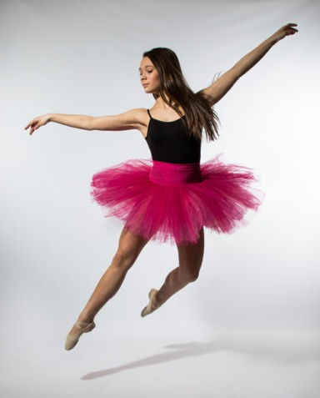
ANNA KATE JORDAN
Texas High School, TX

Slide 72
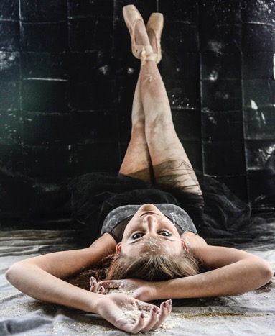
MADDY EMERSON
Pittsburg High School, KS

Slide 73
Scenario
It’s March.
Final deadline time.
The HEAD COACH announces his RETIREMENT after 44 years on the sidelines of a POWERHOUSE Texas football program.
You want to include that COVERAGE. It’s important to the history and students of your school.
It starts with an iconic ENVIRONMENTAL PORTRAIT.

Slide 74
CALLI MAROULIS
Highland Park High School, TX

Slide 75
HIGHLAND PARK HIGH SCHOOL
Dallas, TX

Slide 76
BEAUTIFUL, RIGHT?
There’s a TWIST.
In April, he ANNOUNCES his RETURN. No retirement.
Time to make LEMONADE
out of LEMONS.

Slide 77
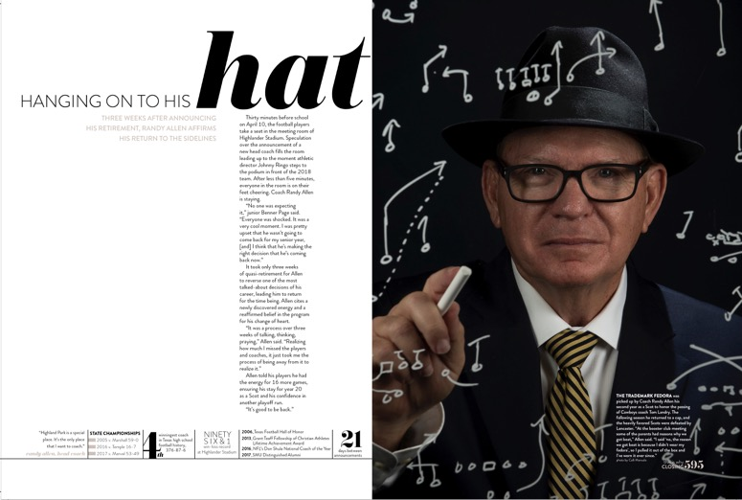
HIGHLAND PARK HIGH SCHOOL
Dallas, TX

Slide 78
TIPS FOR CAPTURING & USING STORYTELLING IMAGES
SHOOT IMAGES BEFORE, DURING & AFTER A MAJOR EVENT.
COME EARLY; STAY LATE.
TAKE VIEWERS SOME PLACE THEY CAN’T GO.
VISUAL VARIETY - WIDE SHOTS, MEDIUM SHOTS, CLOSE UP/DETAIL
SHOOT VERTICAL & HORIZONTAL IMAGES.

Slide 79
MORE TIPS…
ENSURE EVERY IMAGE HAS A CENTER OF VISUAL INTEREST.
USE YOUR ZOOM LEGS.
TAKE SINGLE SUBJECT, SMALL GROUP & CROWD IMAGES.
DON’T SHOOT AN EVENT THE SAME WAY EACH YEAR.
MAKE SURE EVERY SPREAD HAS A PHOTO GOOD ENOUGH TO ENTICE YOUR READERS TO TURN THE PAGE TO SEE MORE.

Slide 80
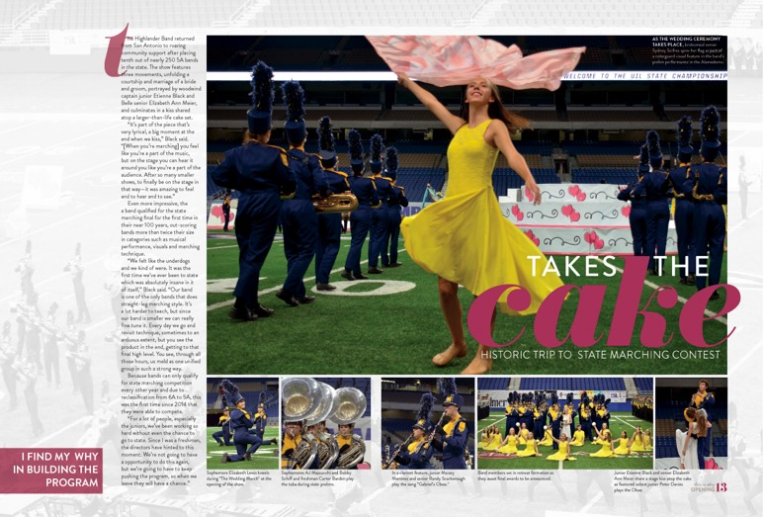
HIGHLAND PARK HIGH SCHOOL
Dallas, TX

Slide 81
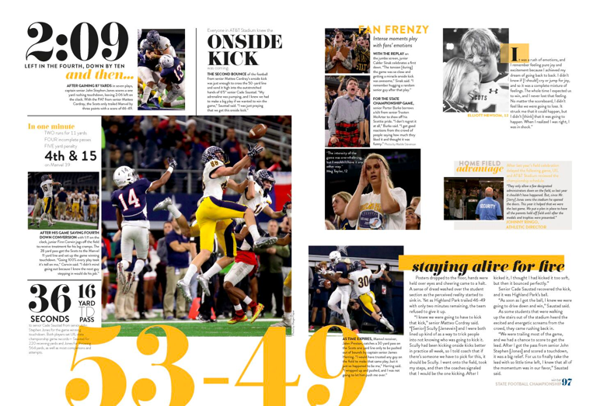
HIGHLAND PARK HIGH SCHOOL
Dallas, TX

Slide 82
ROUND ROCK HIGH SCHOOL
Round Rock, TX

Slide 83
ROUND ROCK HIGH SCHOOL
Round Rock, TX

Slide 84
CAPTION WRITING
EASY AS 1 - 2 - 3 - 4
You need a STORYTELLING photo.
PHOTOGRAPHERS MUST DO THEIR PART; IT’S HARD TO WRITE A GREAT CAPTION FOR A PHOTO OF A STUDENT PROPPED UP AGAINST A WALL.

Slide 85
1
BEGIN with a tie-in to the photo. Can be a mini headline or a unique beginning to the caption, which connects reader to photo verbally & visually.
ARTIST AT WORK.

Slide 86
2
FIRST SENTENCE. Answers who, what, when, where and is written in present tense with action verbs and visual nouns.
Outside the art classrooms in the early morning September shade, senior Rachel Barber paints a billboard for the Art Club’s entry in homecoming.

Slide 87
3
SECOND SENTENCE. Gives info not seen in the photo, written in past tense. Can answer why and/or how.
The theme for homecoming was under the sea fantasy, and the club won third place in the contest.

Slide 88
4
END with a meaningful quote from a key person in the photo. Ask why or how questions for the quote. Add photo credit.
“I sketched my idea first,” then painted the billboard with acrylics. i worked outside so it would dry faster.” Barber said. (Jake Deen photo)

Slide 89
ARTIST AT WORK.
Outside the art classrooms in the early morning September shade, senior Rachel Barber paints a billboard for the Art Club’s entry in homecoming. The theme for homecoming was under the sea fantasy, and the club won third place in the contest. “I sketched my idea first,” Barber said, “and then painted the billboard with acrylics. i worked outside so it would dry faster.” [Jake deen photo]

Slide 90
A FEW MORE TIPS
AVOID STARTING WITH A NAME, ING WORD OR OBVIOUS PHRASE, “PENCIL IN HAND.”
DON’T QUOTE FACTS. ASK WHY OR HOW QUESTIONS.
TALK TO THE PHOTOGRAPHER WHO TOOK THE PICTURE. HE/SHE WAS THERE. HE/SHE HAS INFO.
MAKE SURE NAMES ARE SPELLED CORRECTLY.
ID ALL KEY PEOPLE IN PHOTO.

Slide 91
A FEW MORE TIPS
ID LEFT TO RIGHT, BUT DON’T USE DIRECTIONAL TERMS.
TRY TO NOT REPEAT KEY WORDS USED IN HEADLINE AND FIRST SENTENCE.
DON’T STATE THE YEAR, USE THE WORDS “THIS YEAR,” NAME YOUR SCHOOL OR MASCOT. THOSE ARE OBVIOUS.
AVOID ADVERBS, LY WORDS AND EXCESSIVE USE OF ADJECTIVES.
NO OPINION UNLESS IT’S IN A QUOTE.

